Slide 1
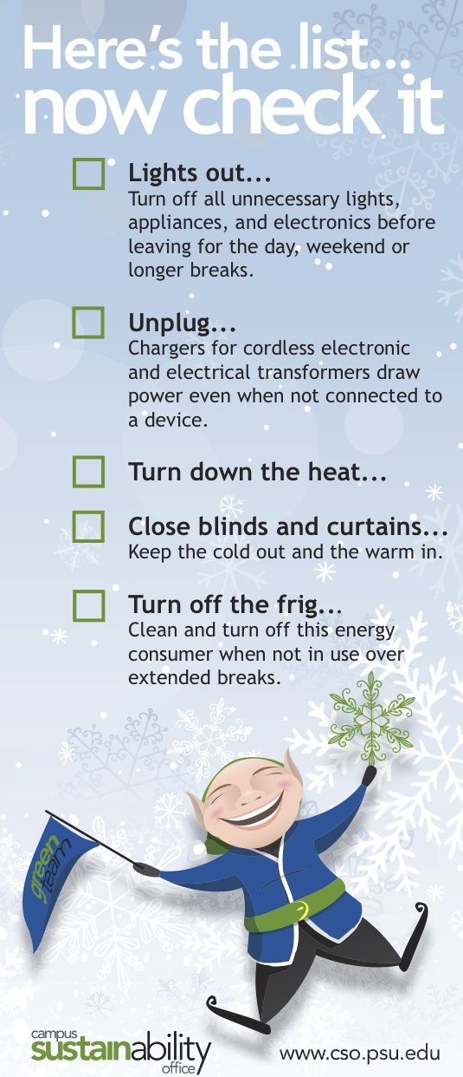
Pitch a Zero Energy
Shutdown!
December 6, 2012
Green Team Lunch

Slide 2
Agenda for Today
Updates with Lydia
Be sure to grab your lunch first
What to look for in diverse audiences
Jeremy & Rob let you know
Pitch the Energy Shutdown to your Audience
Discussion
Post lunch talk about mindsets- Homer vs. Spock from 1:00-1:15
Discuss any topics with Lydia until 1:30

Slide 3
Curriculum
Co-curricular
Research
The Sustainability Institute
Engagement
Operations

Slide 4
Upcoming Events
December 13th: Grapevine out
December 21st: Holiday Shutdown
January 14th: Green Paws 2.0 pilot shuts down
January 17th: Coffee Hour
February 6th: Lunch & Learn – Pesky Lightbulb
February 27th: Green Team Lunch – 12% Challenge

Slide 5
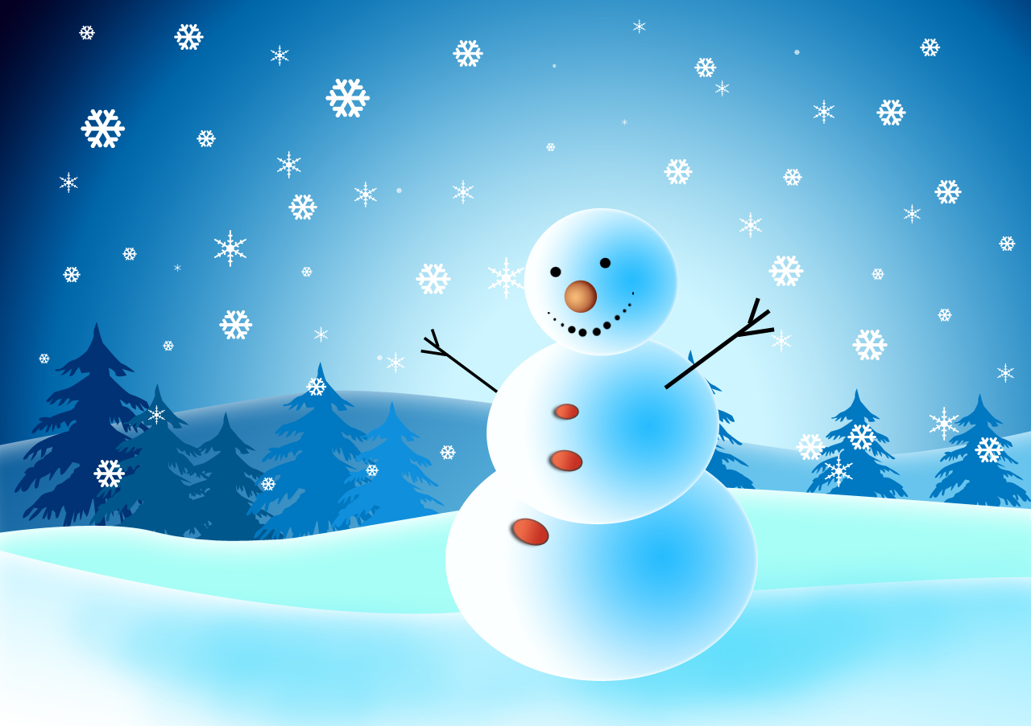
Holiday Shutdown
Use creative ways to shutdown your office
over the holiday break!

Slide 6
There are four main audience types who will hear your message
Friend
Foe
Know-It-All
Clueless

Slide 7
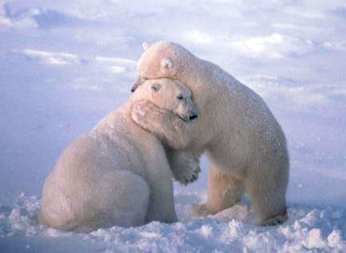
People who are sympathetic to your message and are already on your side.
Friend

Slide 8
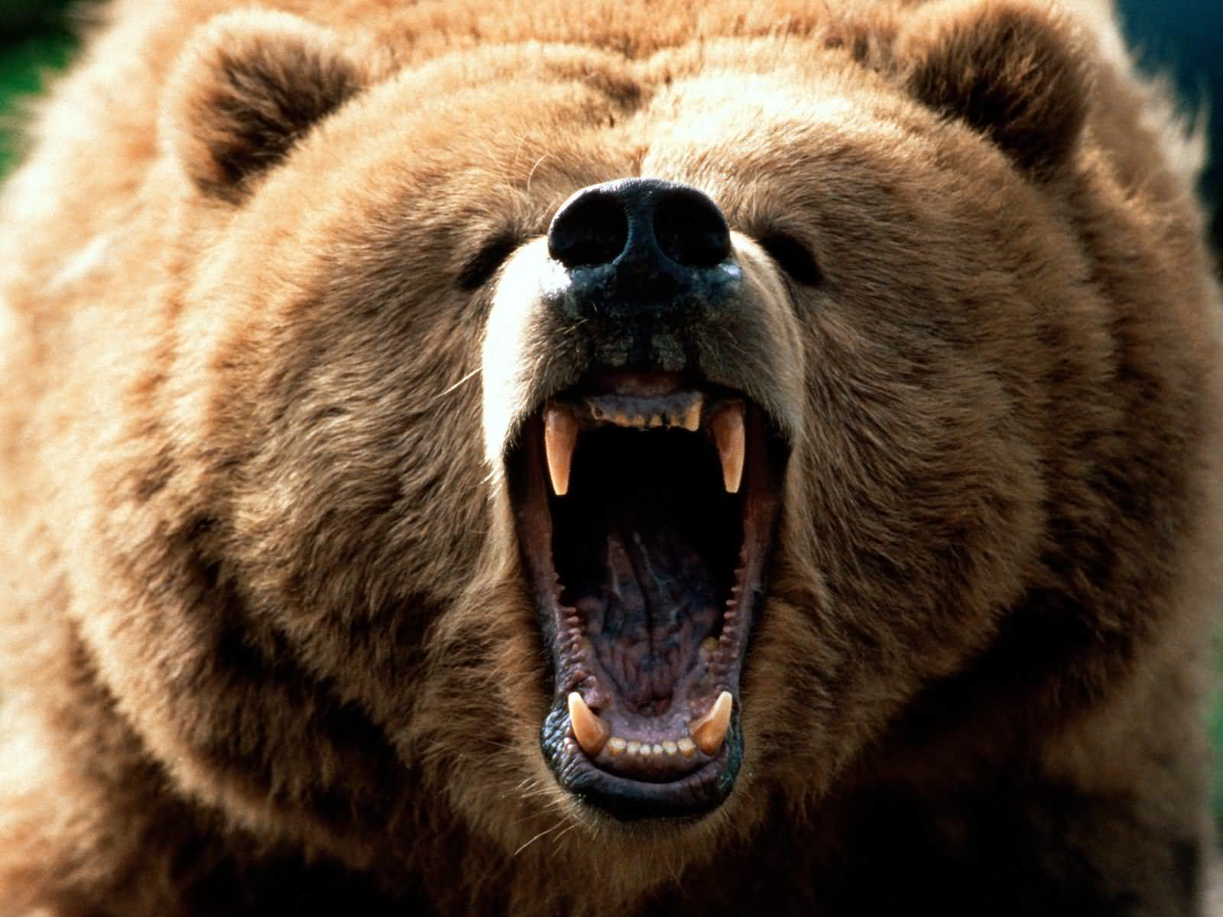
Foe audiences have a predetermined stance that is disagreeable or even hostile. Perhaps they do not want to be there. Perhaps they do not like your group or what you represent.
Foe

Slide 9
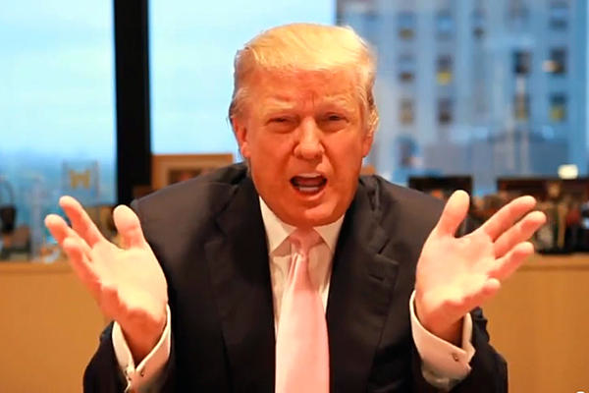
Know-It-All audiences consider themselves intelligent (probably more intelligent than you). They tend to pick holes in what you say and challenge your assertions.
Know-It-All

Slide 10
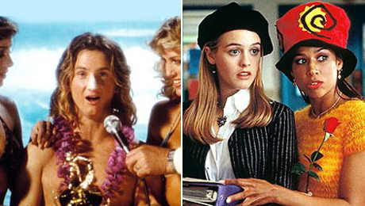
These folks don’t know much about your topic, but that doesn’t stop them from having strong opinions. They may be misinformed or simply lack information.
Clueless

Slide 11
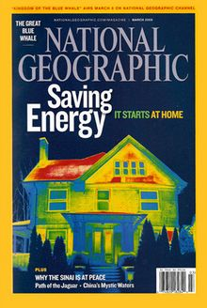
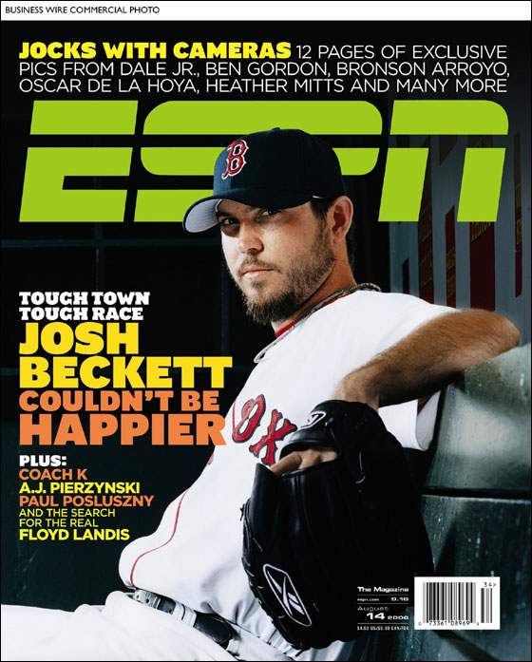
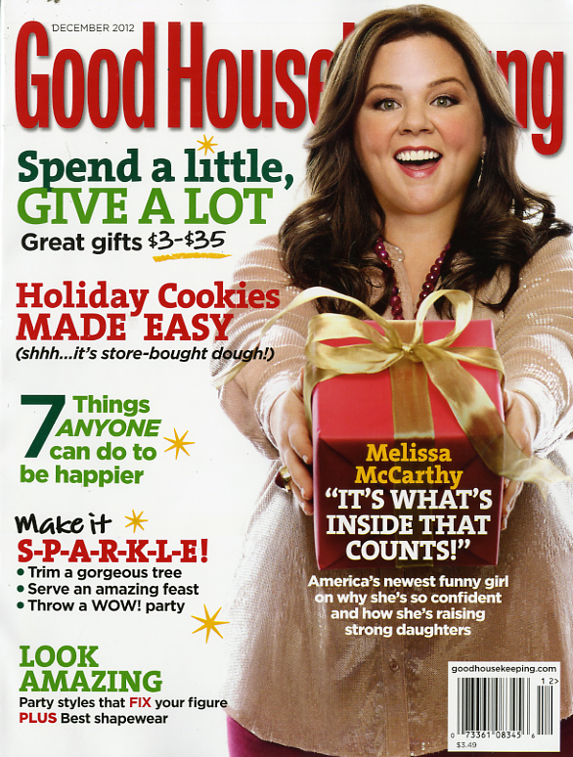
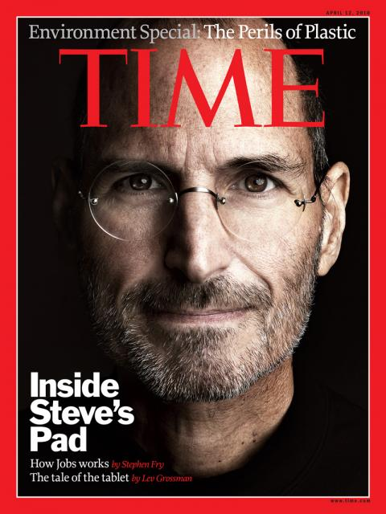

It is important to tailor your message to your audience.

Slide 12

Let’s use Golf Magazine as an example
Reader Characteristics?
Friend, Foe, Know-It-All,
Clueless?
Make the Pitch

Slide 13
Now take out your Full-Page Ad
Your Magazine
General Characteristics of the Reader
Type of Audience
Your pitch
What’s it look like
What’s it say

Slide 14

General Questions?

Slide 15
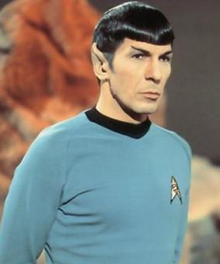
How we view our decision making…
Notes:
Dr. Spock stands for our conscious, rational, deliberate brain. This is the “rule-based system. Controlled, self-aware, effortful, deductive, slow, rule-following

Slide 16
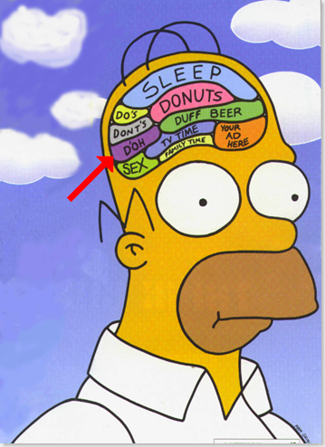
Much closer to the truth
Notes:
Many of our decisions are made in an automatic, unconscious process. Our “Spock” brain is hardly aware. This is the “associative system,” which is intuitive, impulsive, and driven by sensory information. Uncontrolled, effortless, automatic, fast, unconscious, skilled.
Sustainable Behaviors have little appeal to the associative/intuitive side.

Slide 17
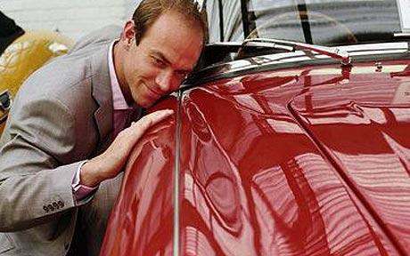
Think for a moment about the thoughts that go into purchasing a car

Slide 18
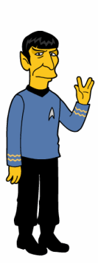
We could all use a little more Spock, but we also need to find ways to make our Spock side appeal to Homer.
Notes:
Must combine the head and the gut. Bring Spock and Homer together. Homer has more fun, but Mr. Spock is much more successful in life.

Slide 19


Slide 20
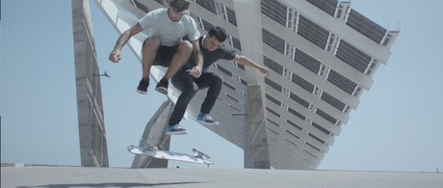
Notes:
http://www.youtube.com/watch?feature=player_embedded&v=M24KaozWR5I

