Slide 1

Bright Ideas for Social Change
Green Teams Lunch & Learn
February 6, 2013

Slide 2
Updates
February 27th Green Team Lunch
12% Challenge and Sharing Successes & Challenges
Registration Opens February 12th
12% Challenge
March 25th to April 5th
Grapevine – tips for your meeting
The Sustainability Institute
Sustainability.psu.edu

Slide 3




Slide 4

The Case
Of the Pesky
Light Bulb

Slide 5
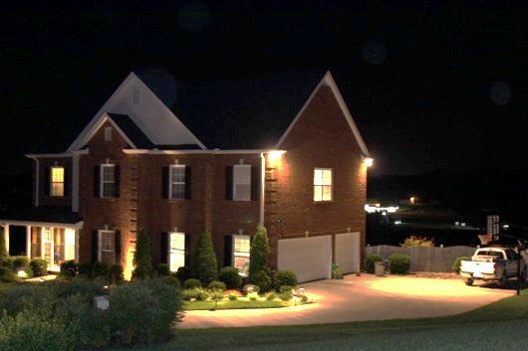

Slide 6
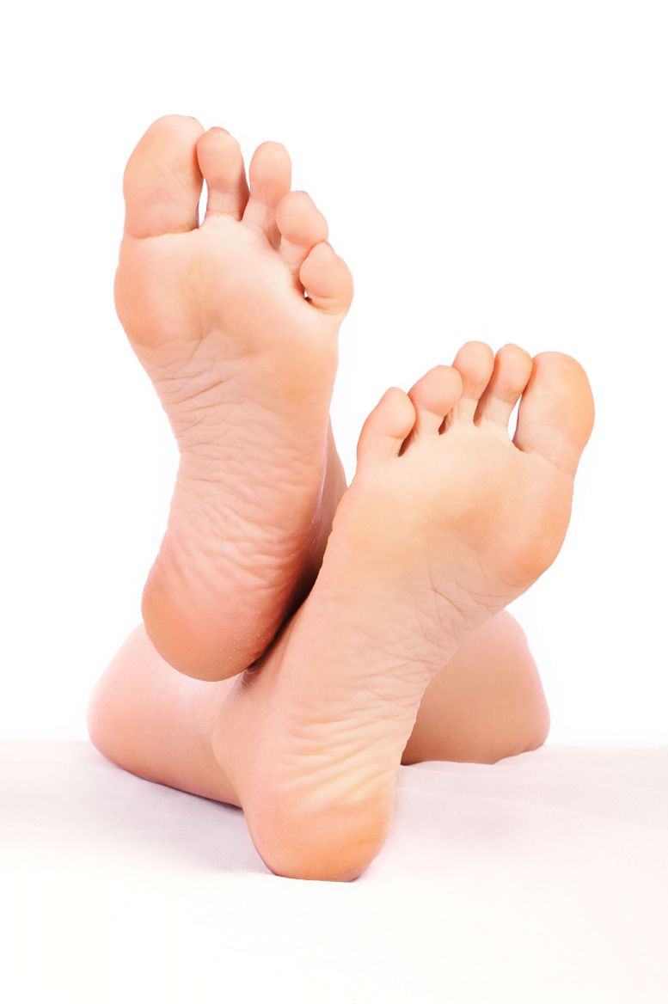

Slide 7
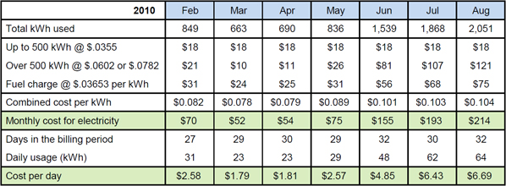

Slide 8
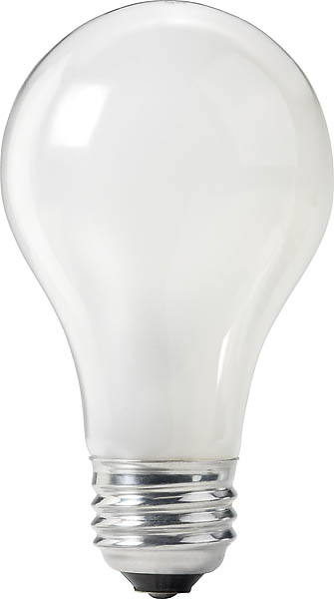
= $12/yr

Slide 9
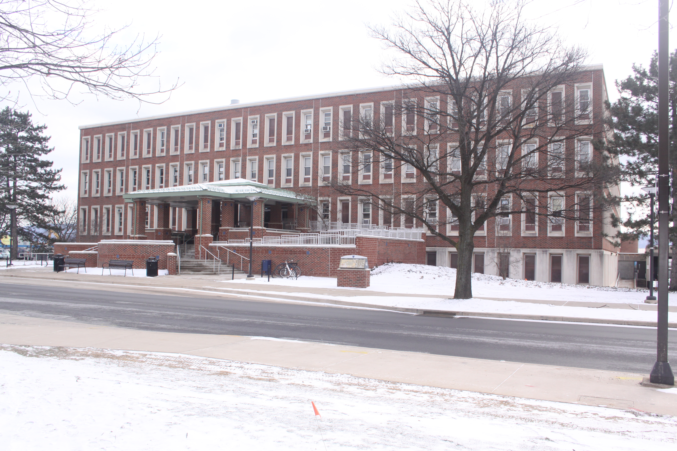

Slide 10
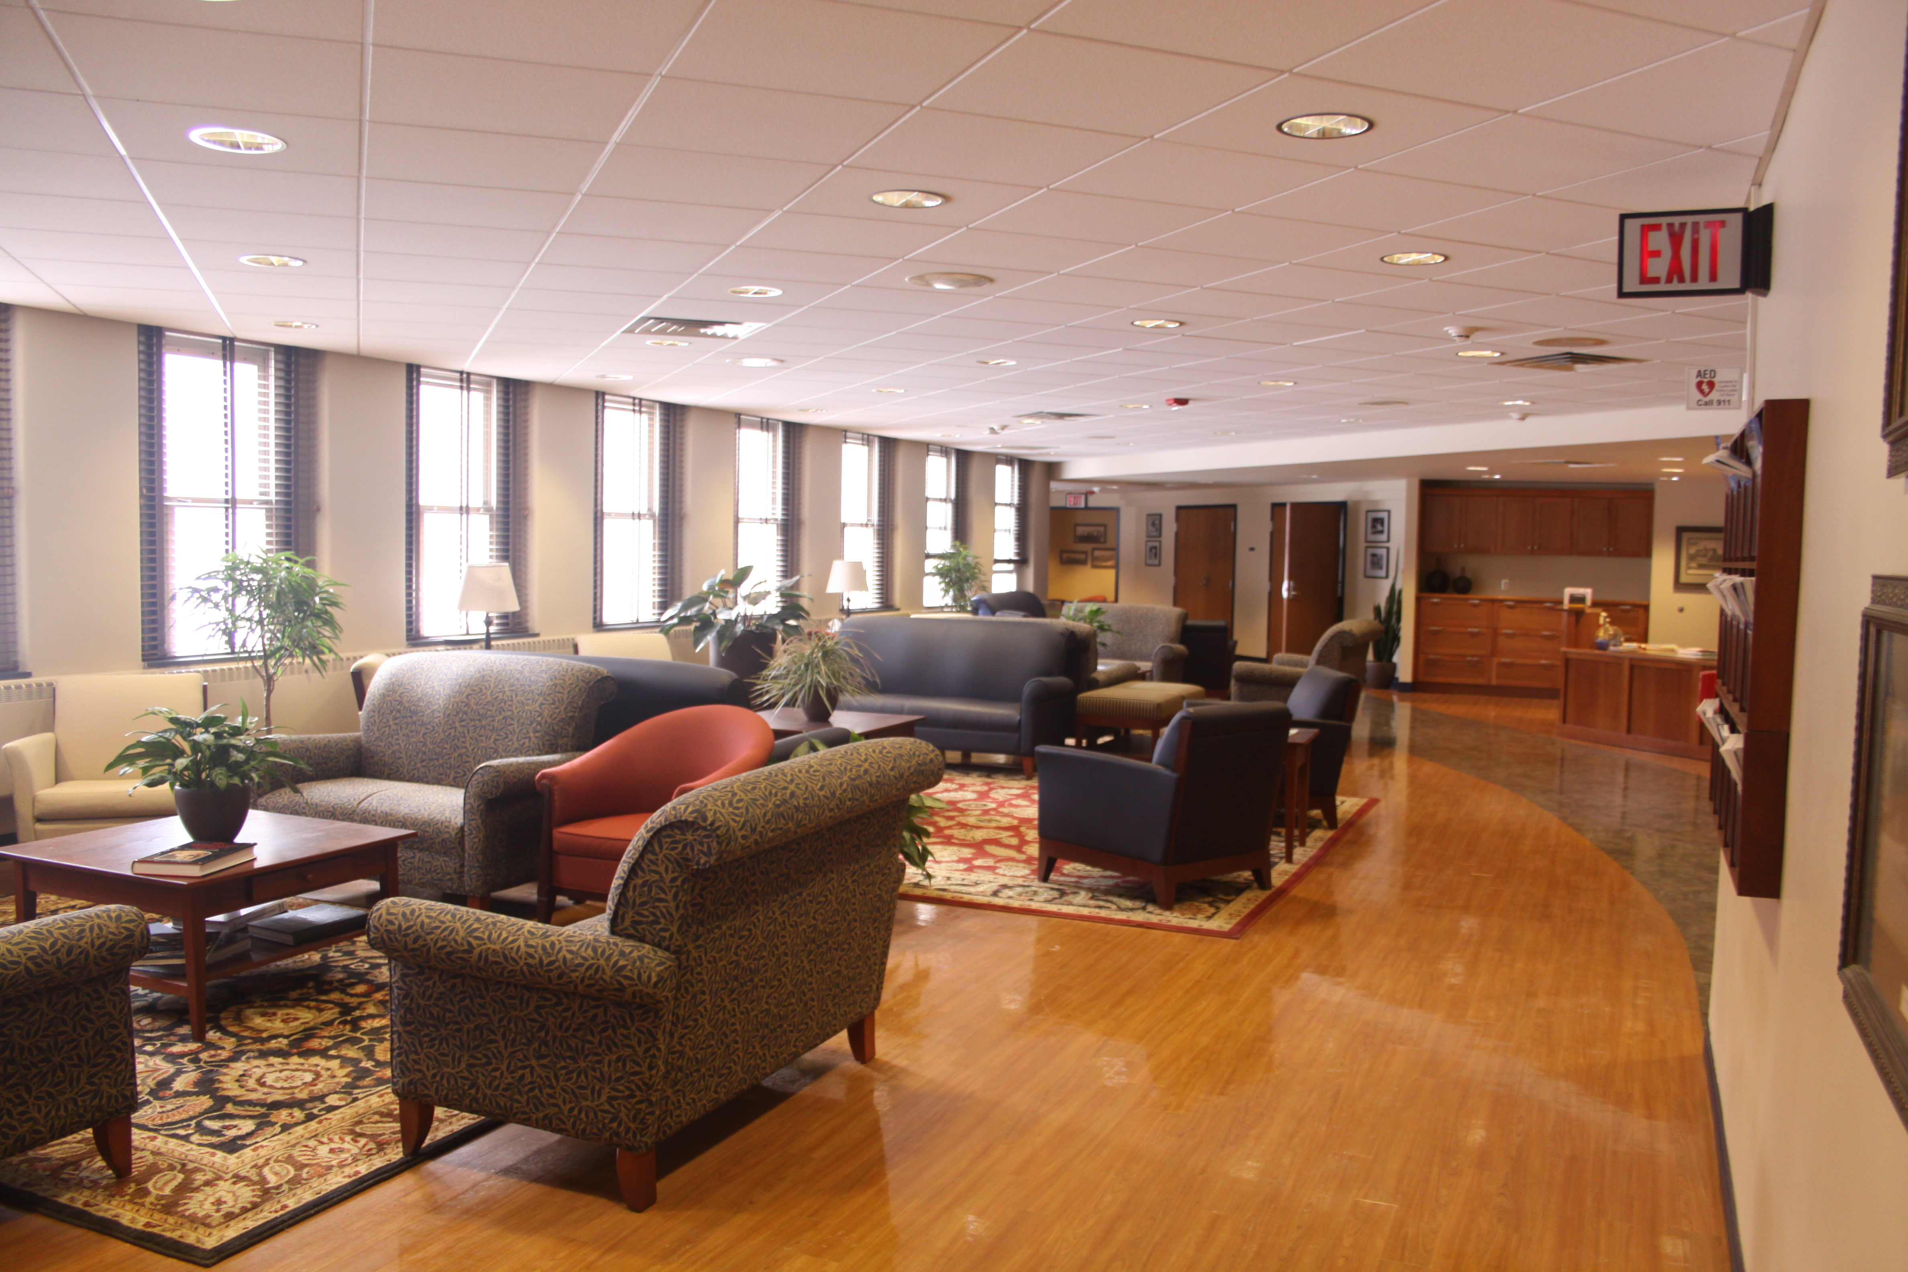

Slide 11
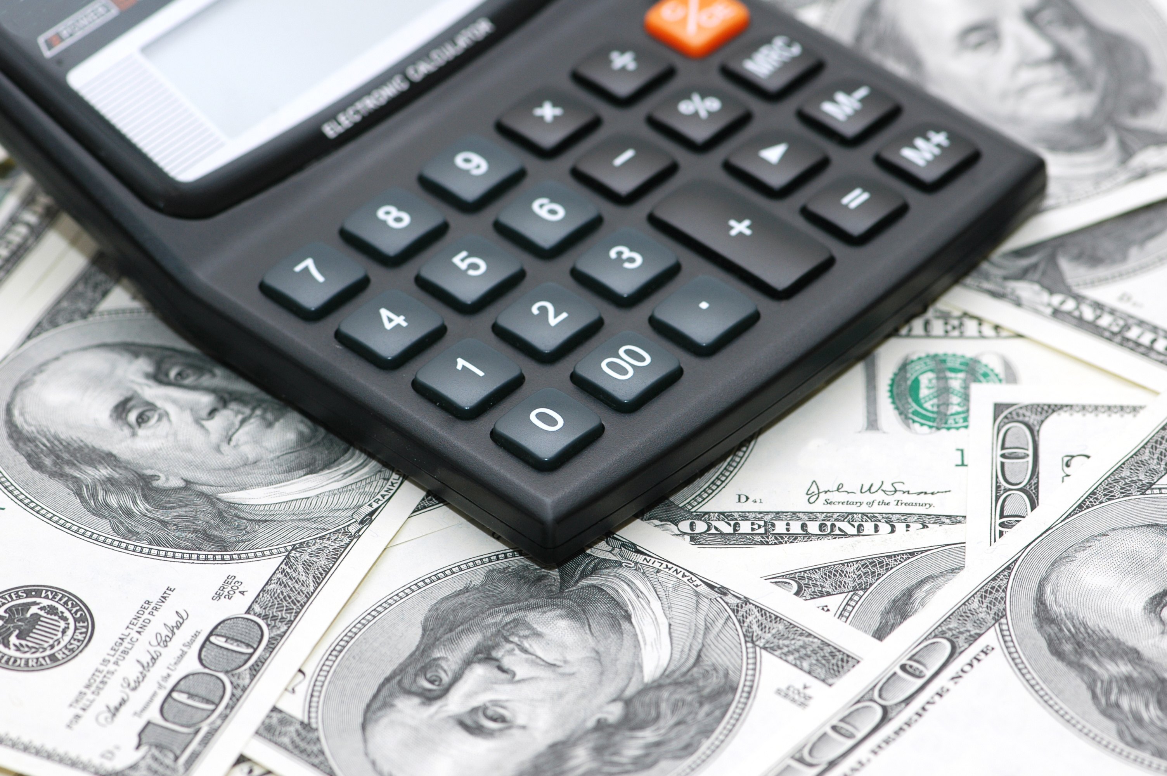
!
Notes:
Using the same formula she did with her son’s homework, she realizes how much money is wasted on the abandoned light!
Need to know the amount

Slide 12
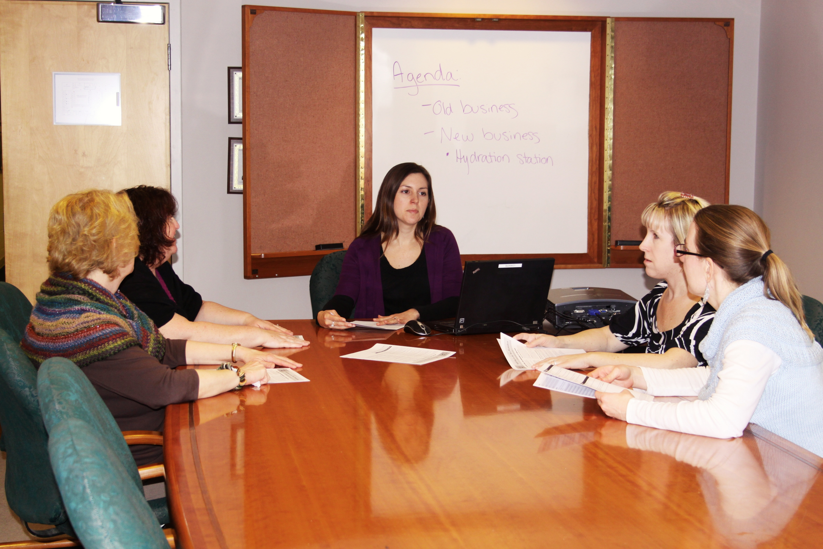

Slide 13
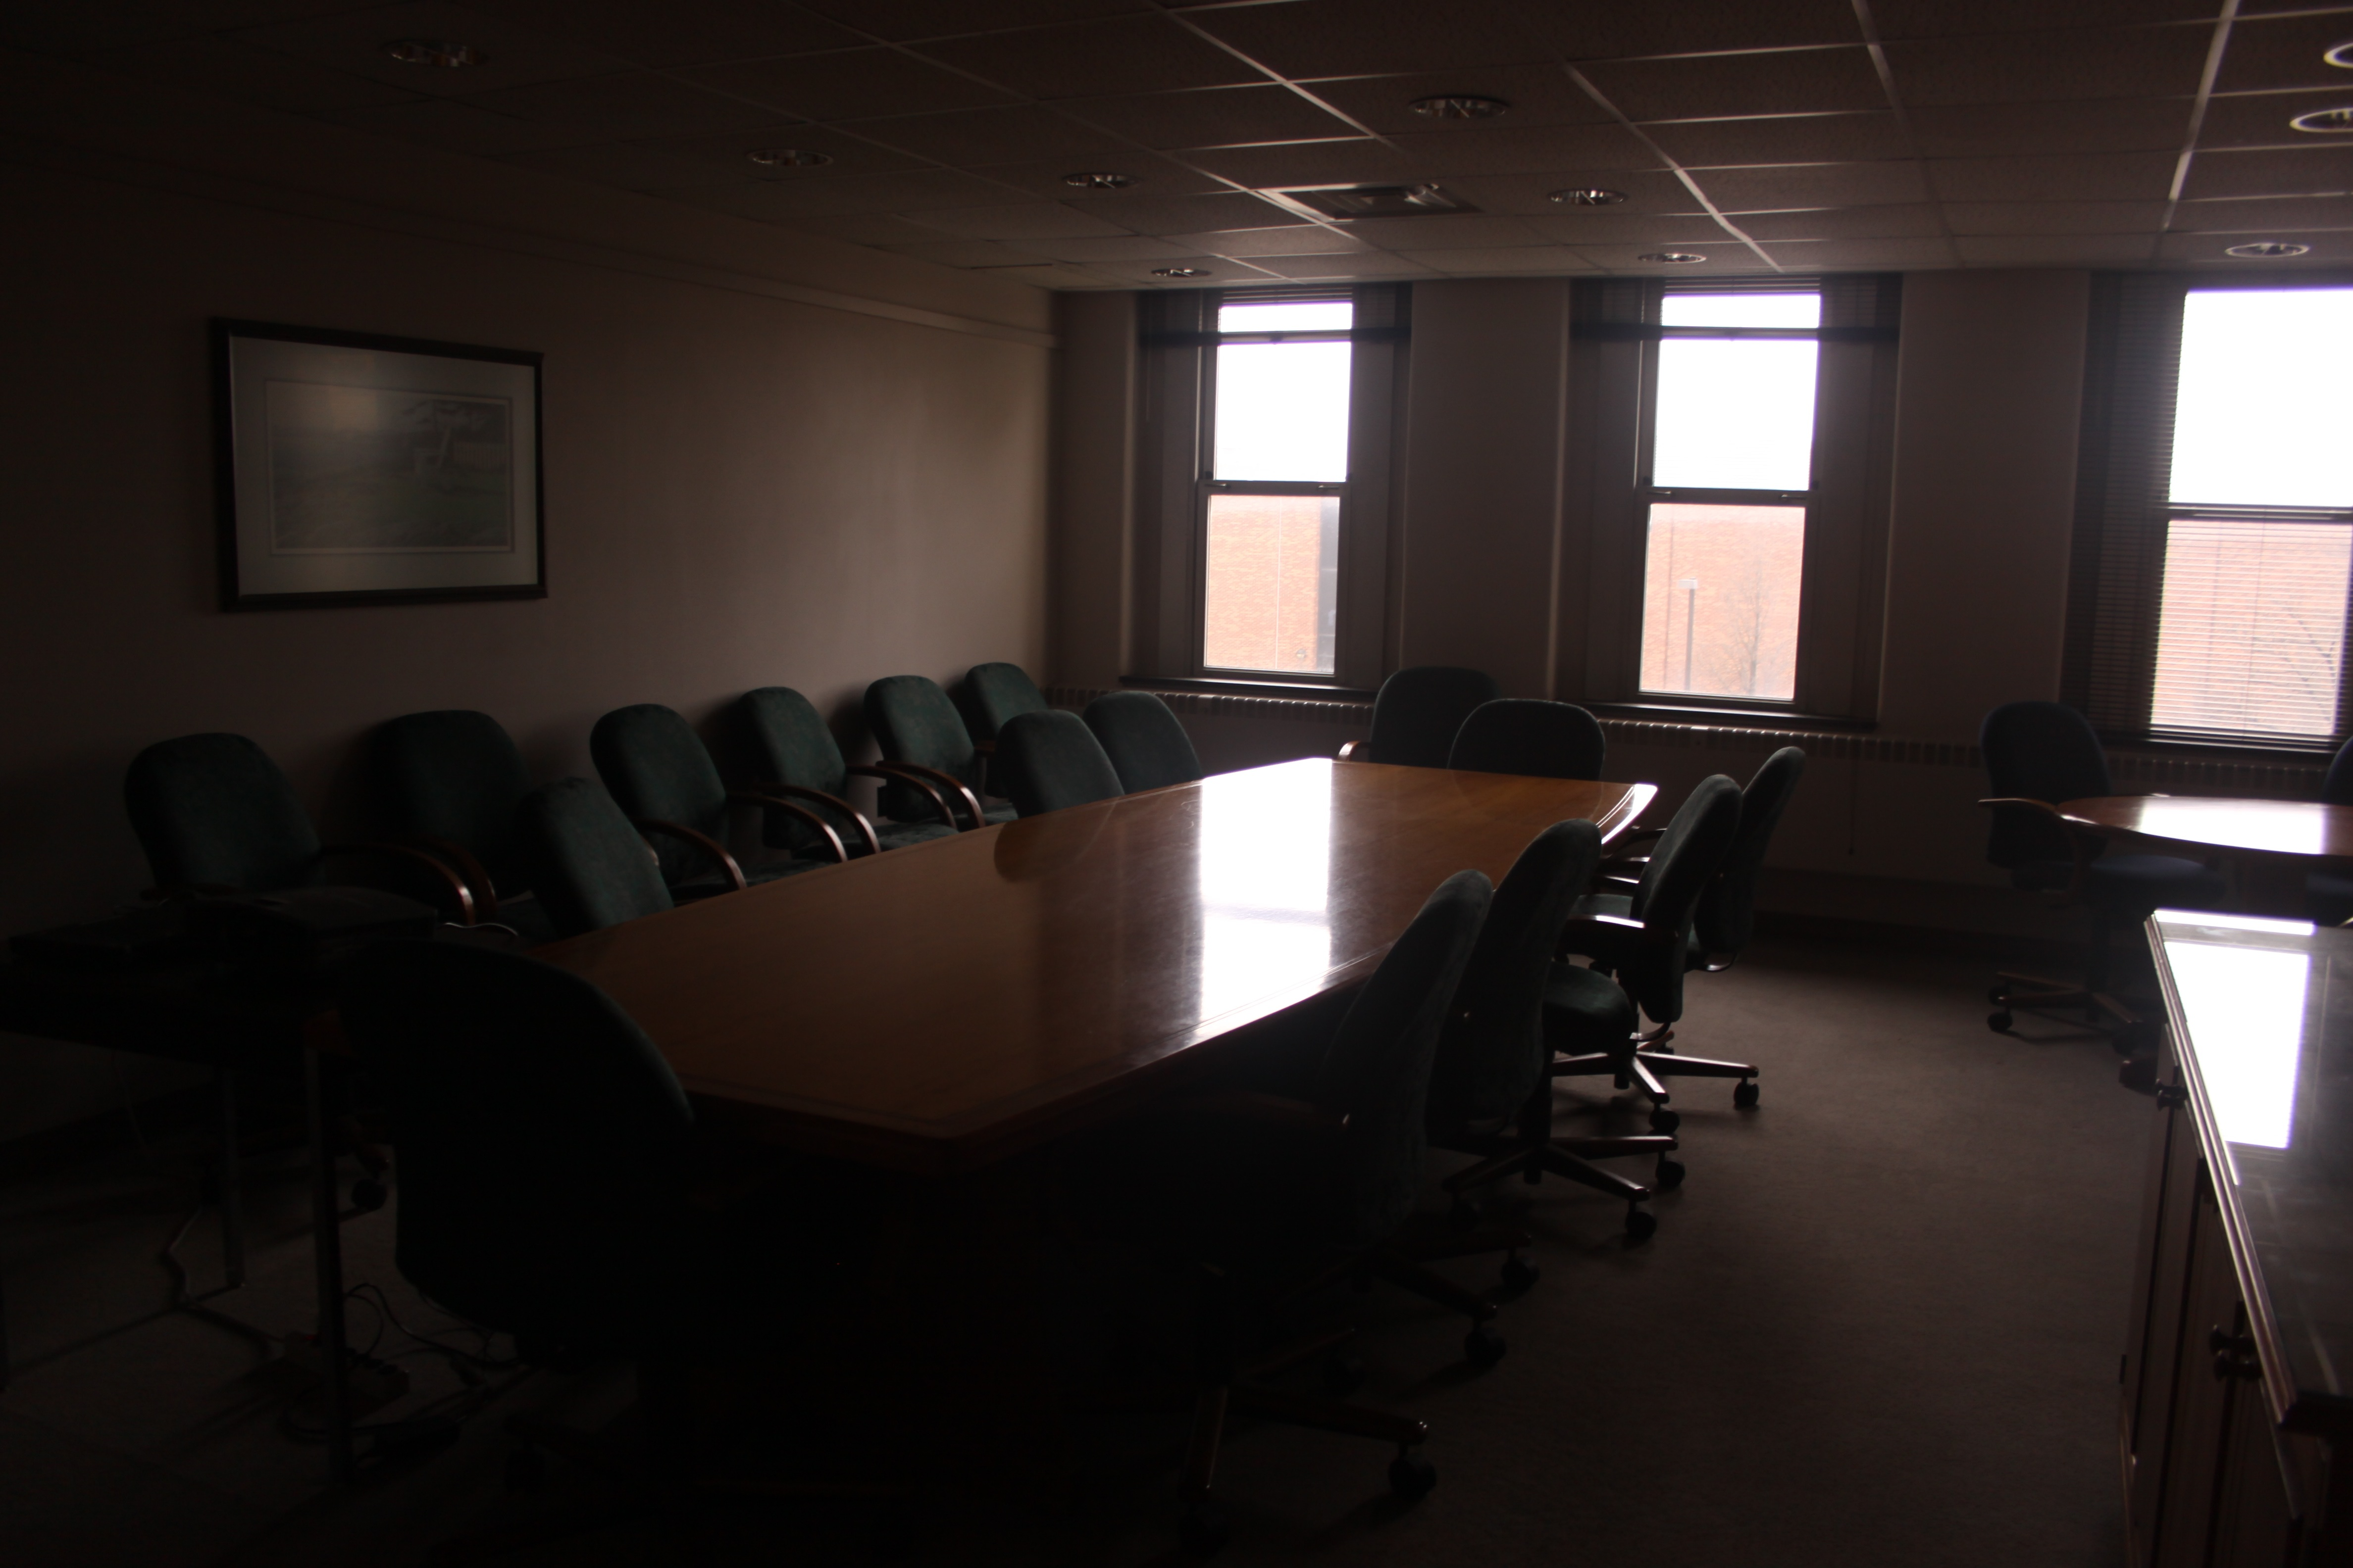

Slide 14
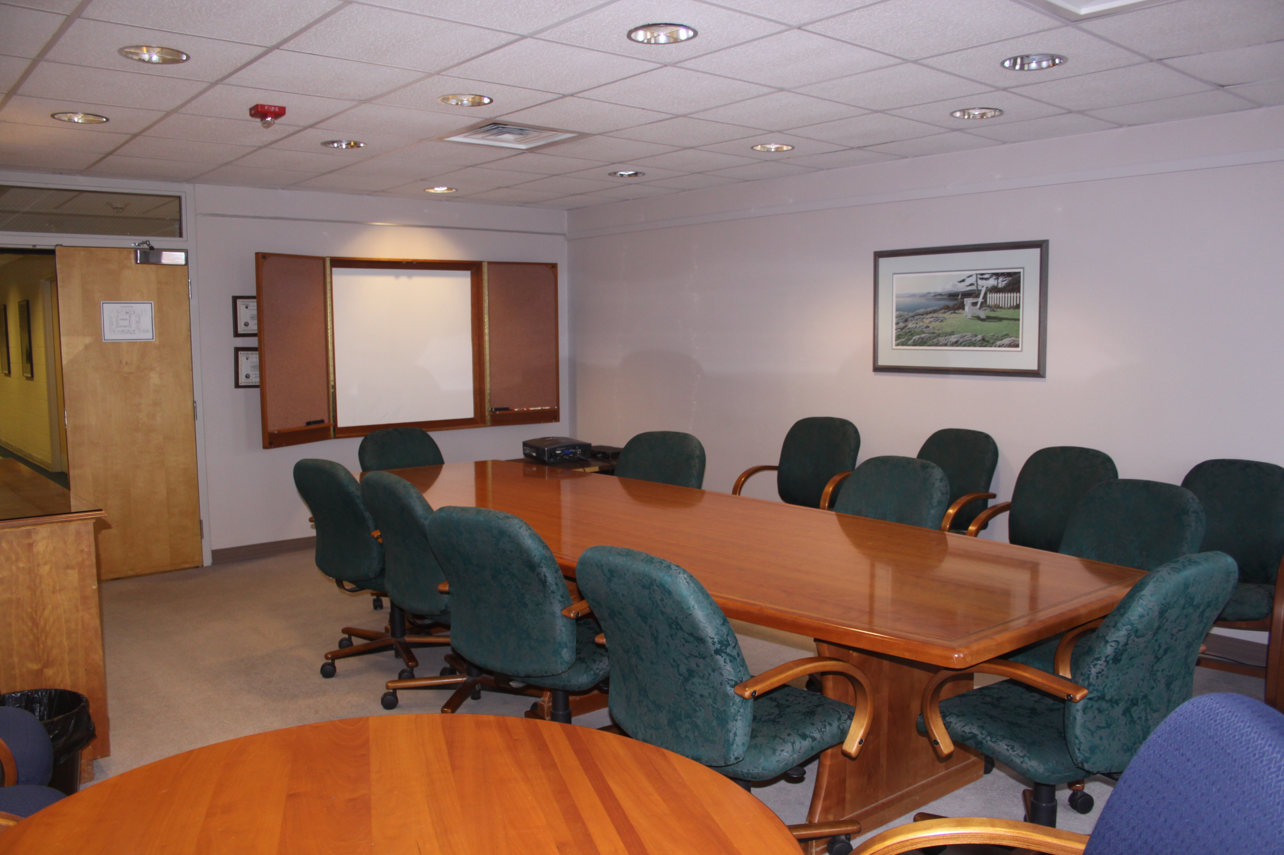

Slide 19
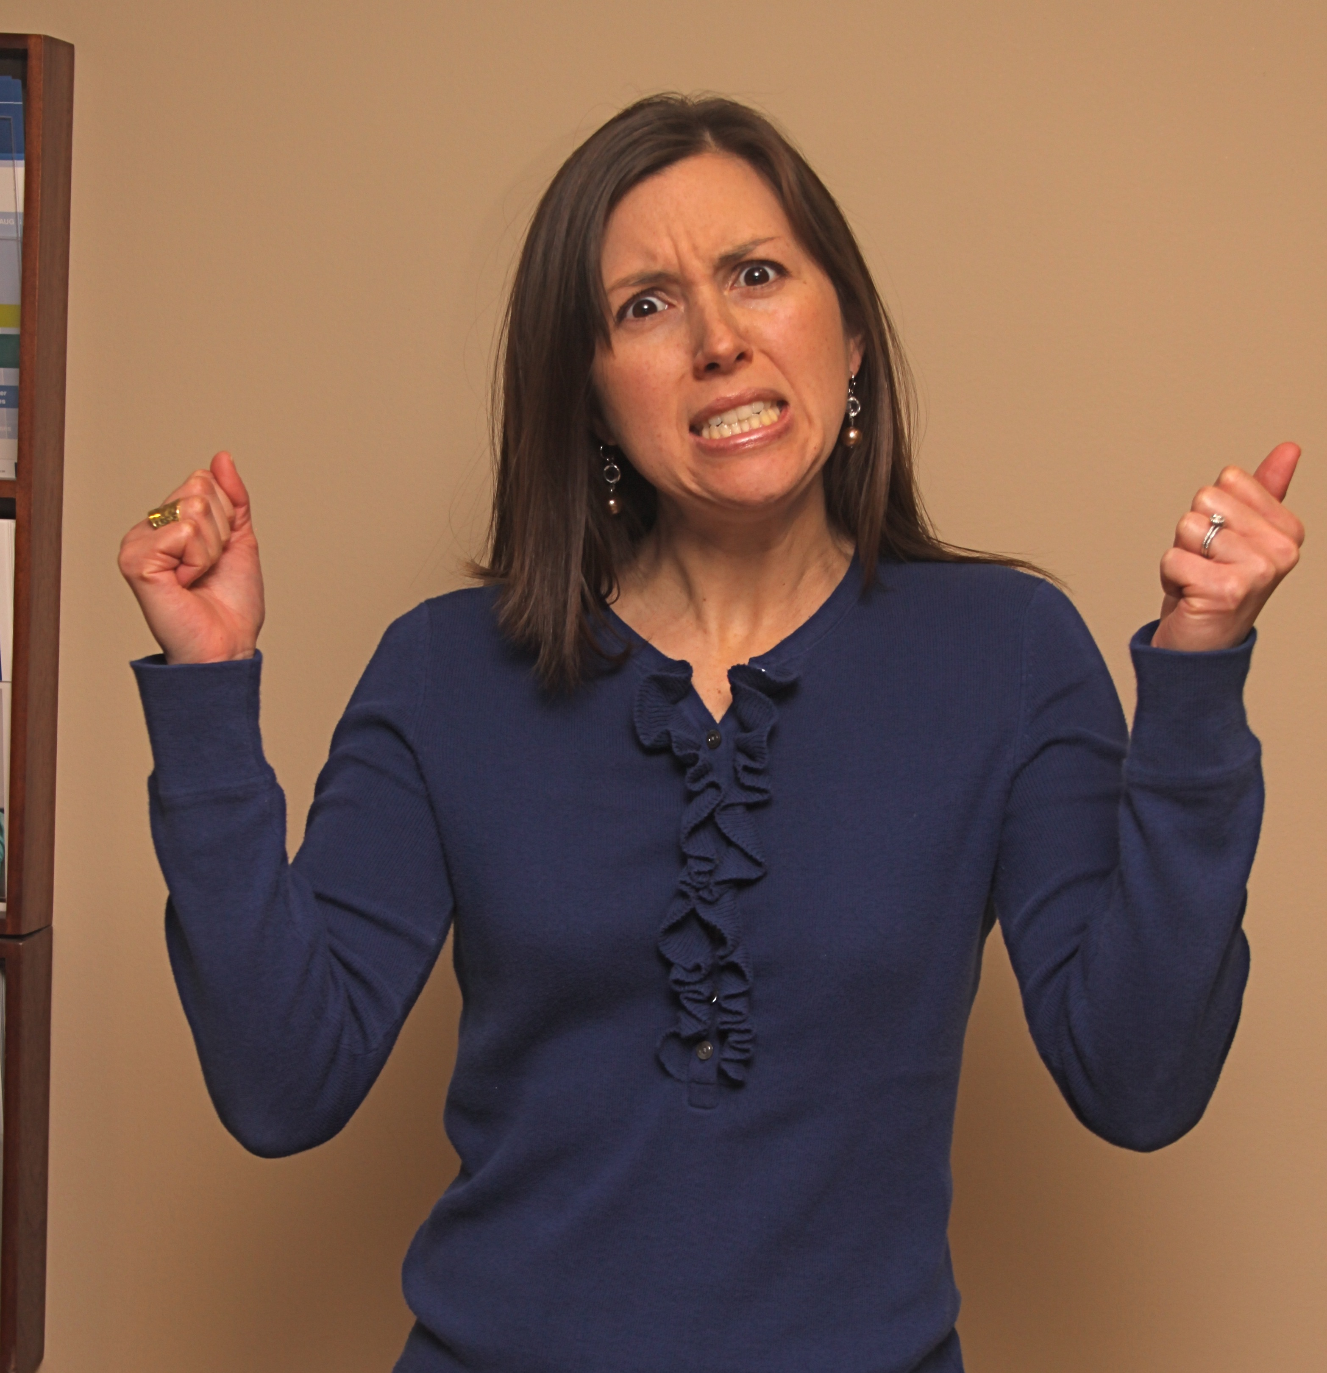
Notes:
This process is mAdDeNiNg!!!

Slide 20

Social Marketing

Slide 21
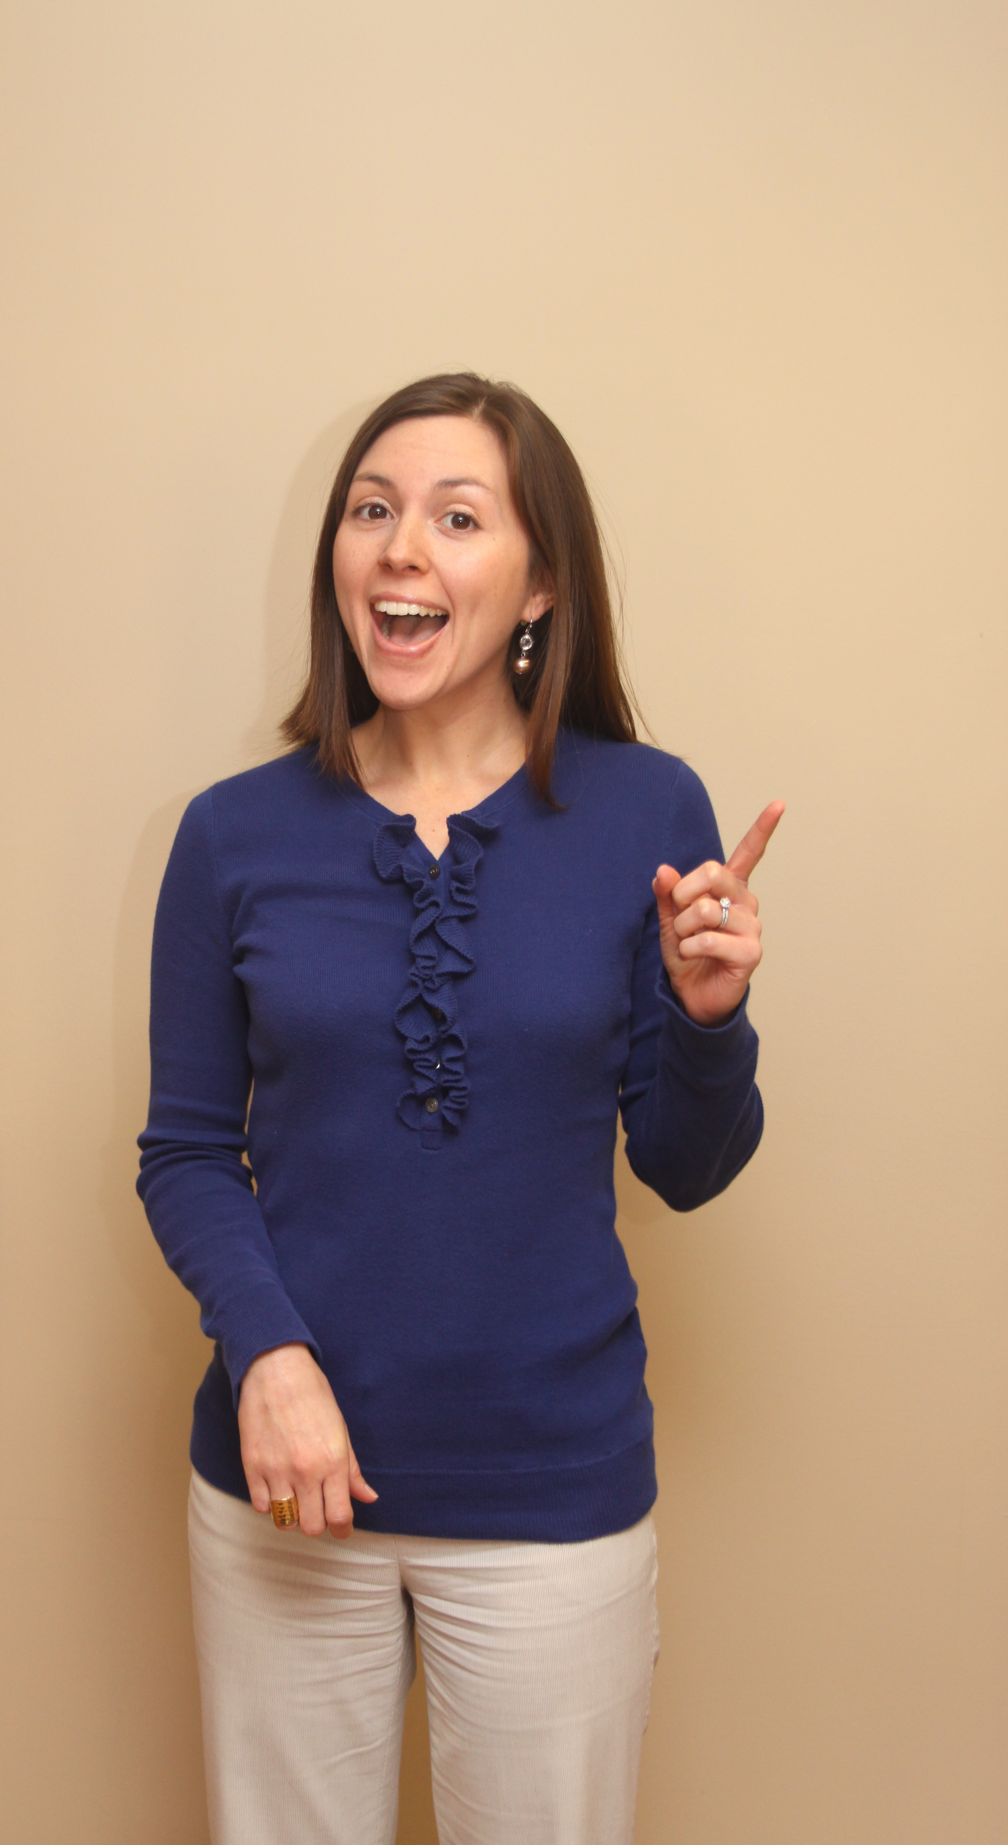


Slide 22
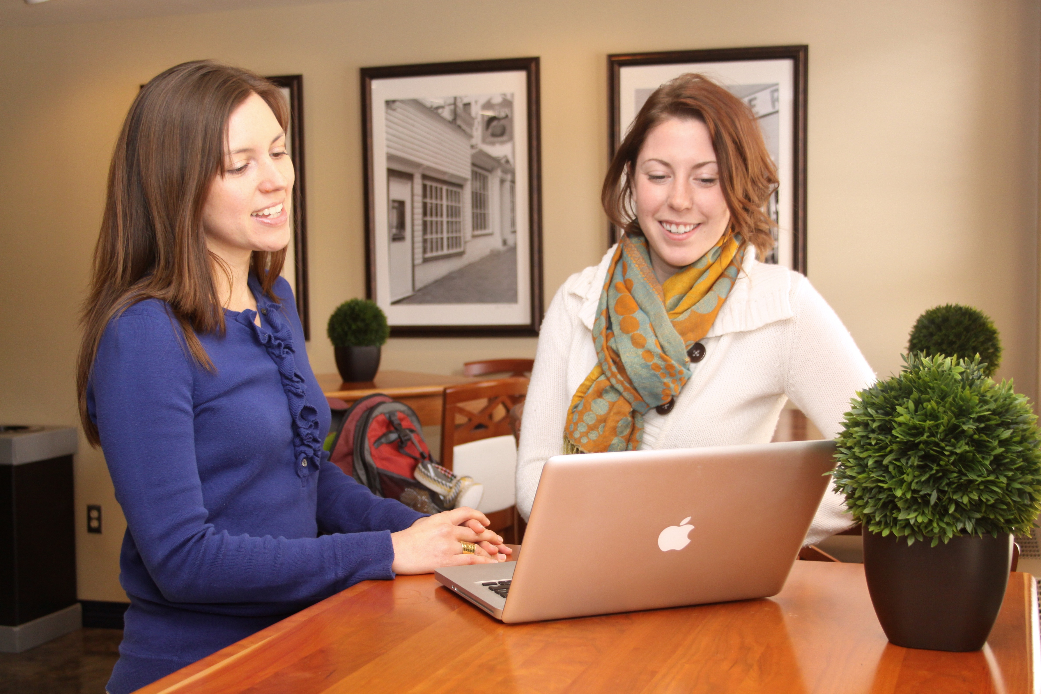

Slide 23
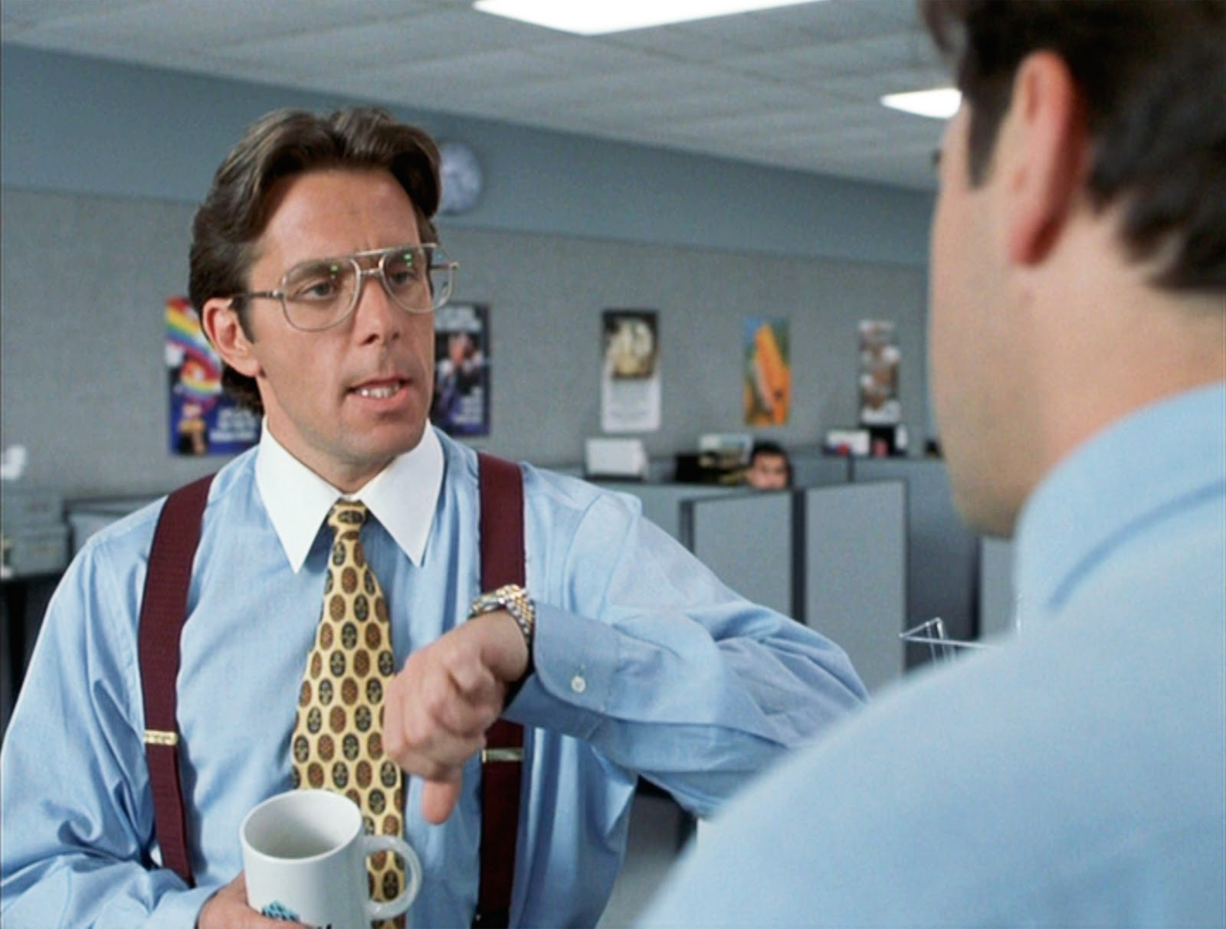
$$

Slide 24
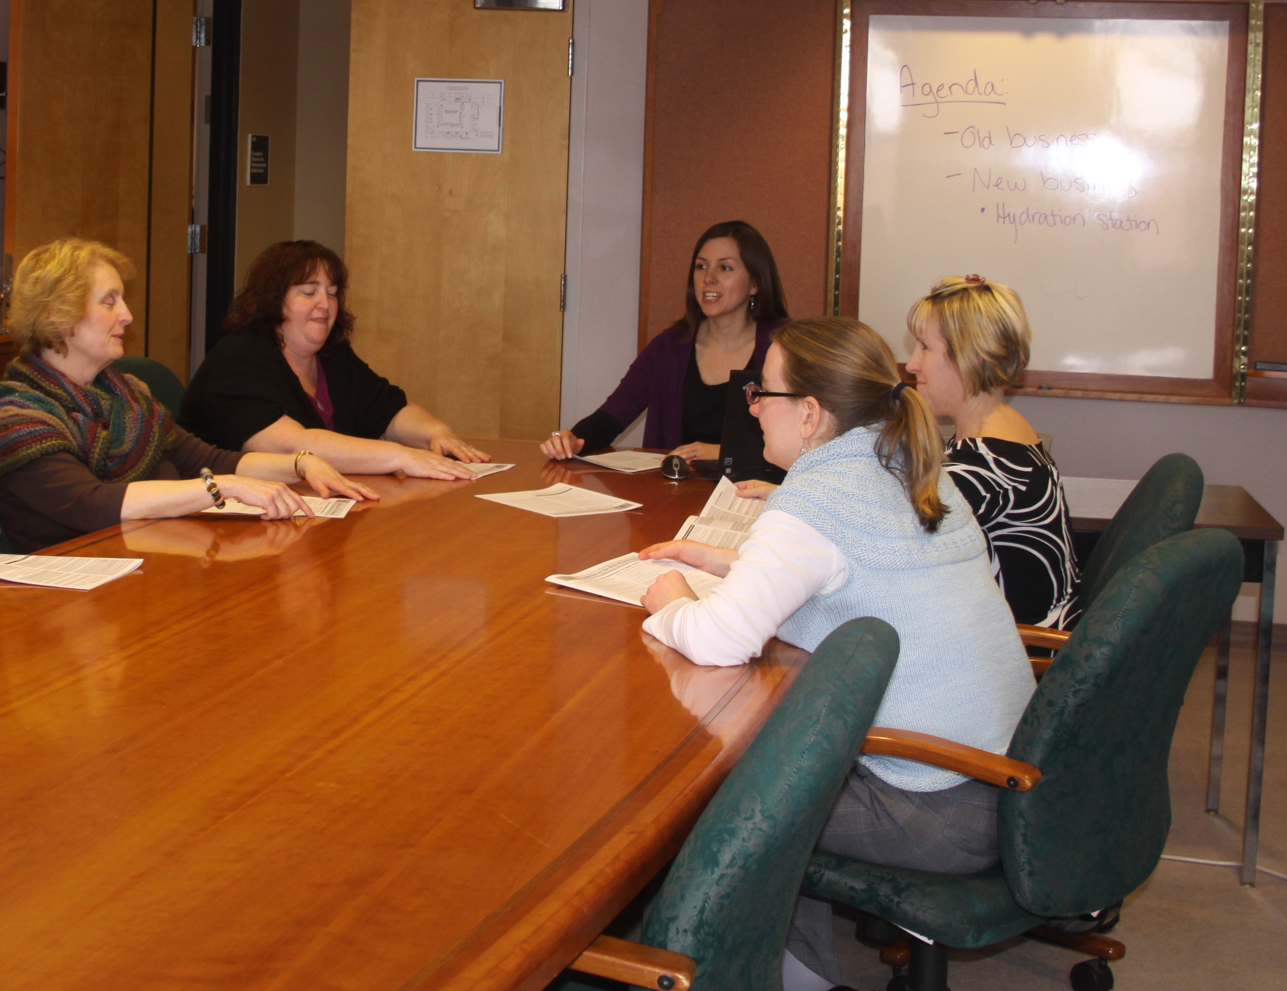
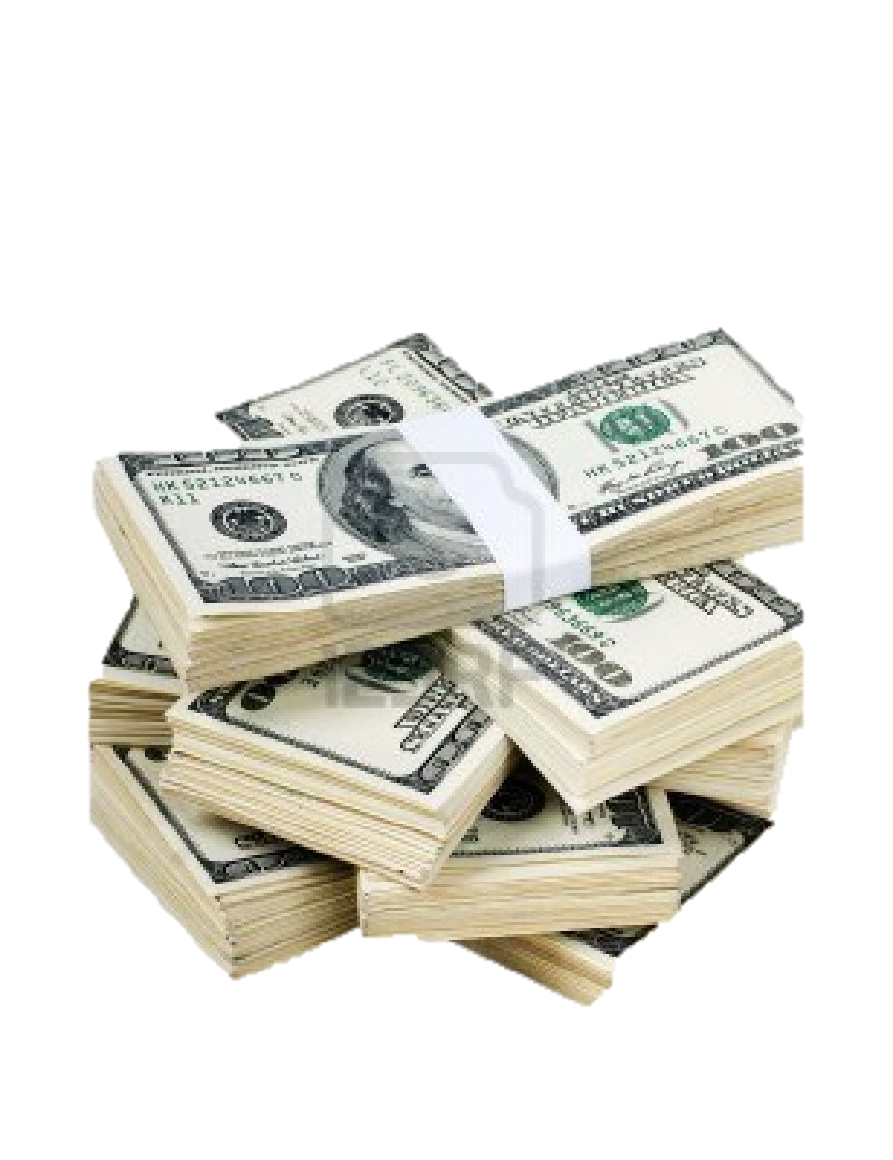

Slide 25
Please
Turn Off The Lights
When Not in Use!
TOTL

Slide 26
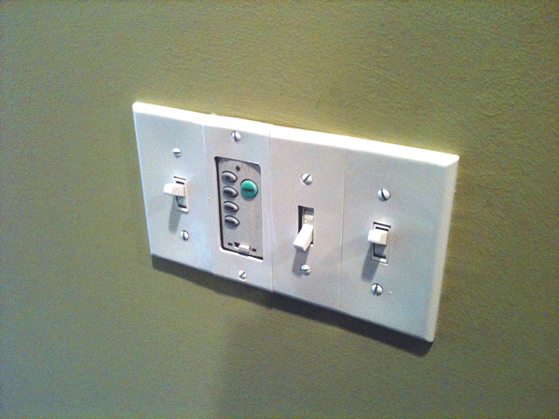

Slide 27
Overhead
Fan
Windows
Back

Slide 28
Sign the Pledge!

Slide 31
CASE
CLOSED
The Case
Of the Pesky
Light Bulb

Slide 32
Why Was She Successful?
Provide Prompts
Make it Easy
Provide Incentive
Get Commitment
Communicate Effectively
Make it Normative
Social
Marketing

